Slide 1
CONFIDENCE INTERVAL

Slide 2
What Is Confidence Interval?
A confidence interval, in statistics, refers to the probability that a population parameter will fall between two set values for a certain proportion of times. Confidence intervals measure the degree of uncertainty or certainty in a sampling method. A confidence interval can take any number of probabilities, with the most common being a 95% or 99% confidence level.
NOTE: Confidence interval and confidence level are interrelated but are not exactly the same.

Slide 3
Understanding Confidence Interval
Statisticians use confidence intervals to measure uncertainty.
For example, a researcher selects different samples randomly from the same population and computes a confidence interval for each sample. The resulting datasets are all different; some intervals include the true population parameter and others do not.

Slide 4
Confidence Interval Vs Confidence Level
A Confidence interval is a range of values that likely would contain an unknown population parameter.
Confidence level refers to the percentage of probability, or certainty, that the confidence interval would contain the true population parameter when you draw a random sample many times.

Slide 5
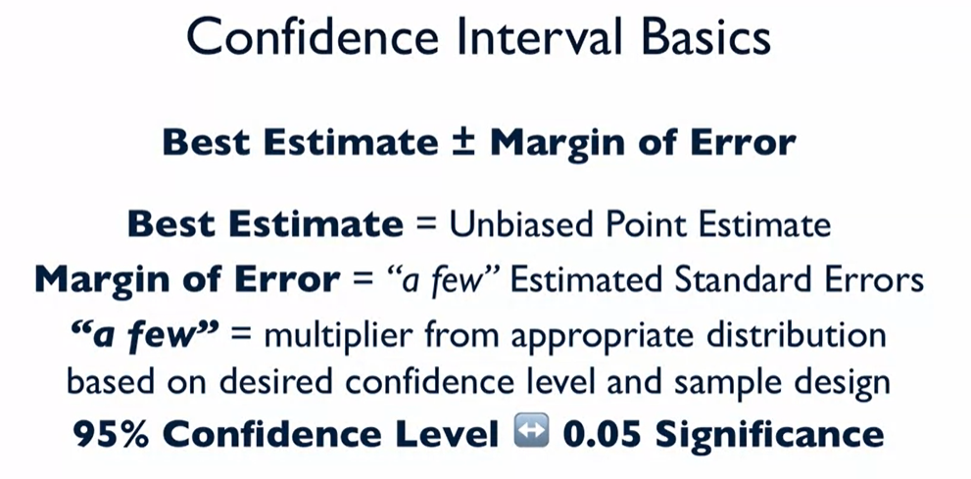
Key Terms

Slide 6

Case Study Example

Slide 7
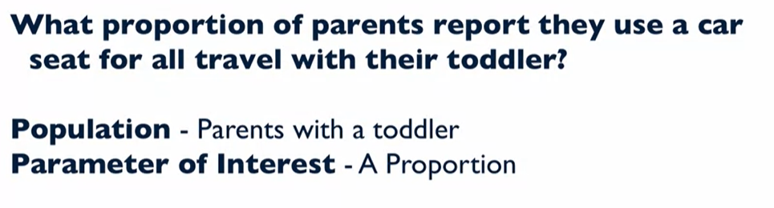
Background Study of the case

Slide 8
Example
Construct a 95% confidence interval for the population proportion of parents reporting they use a car seat for all travels with their toddler?

Slide 9
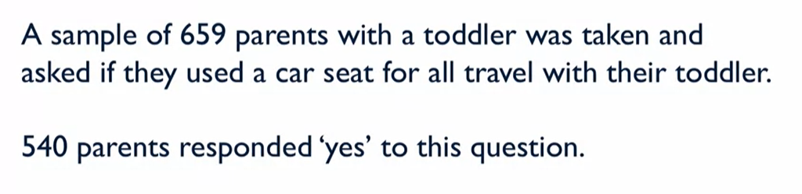
Background study report

Slide 10
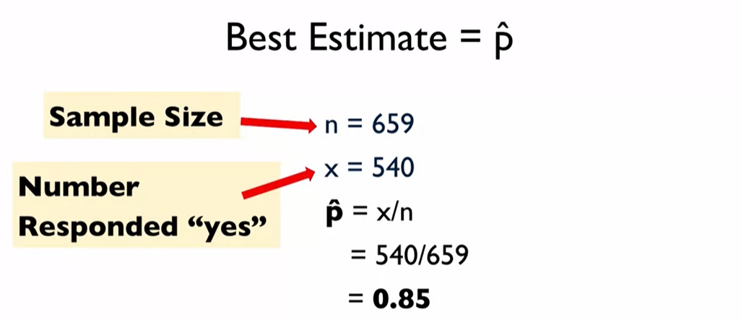
Confidence Interval Calculation

Slide 11
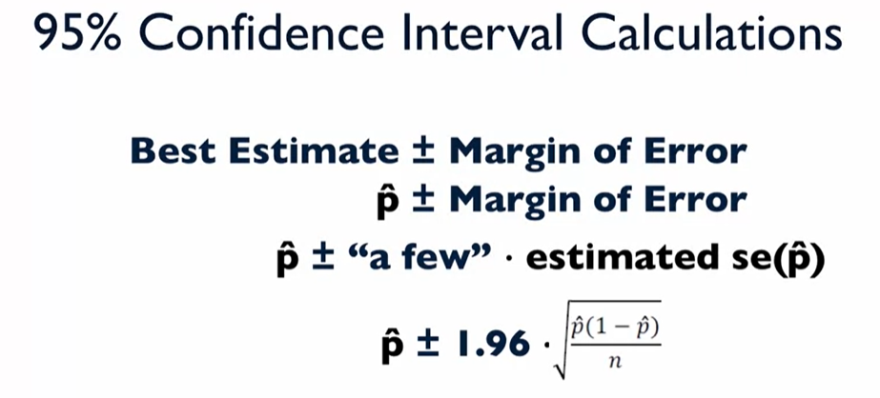
95% Confidence Interval Calculation

Slide 12
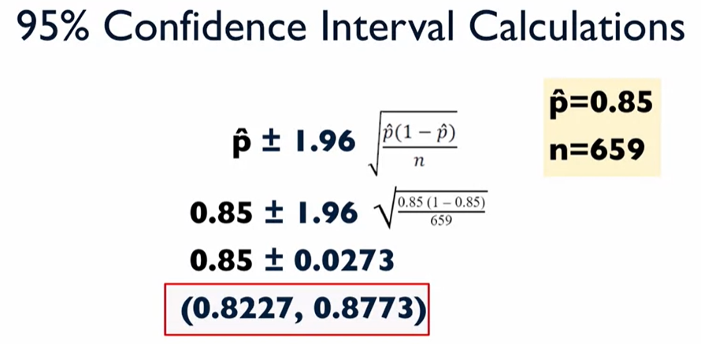
95% Confidence Interval Calculation

Slide 13

Interpretation of CI

Slide 14
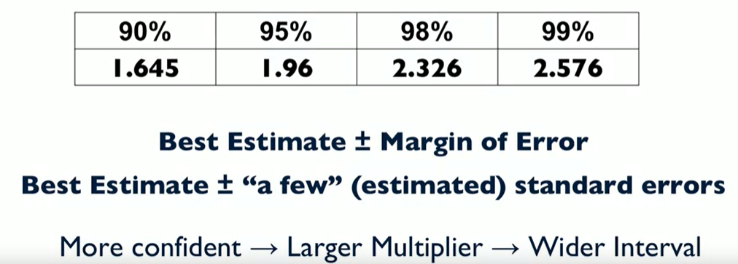
Different Z multipliers

Slide 15
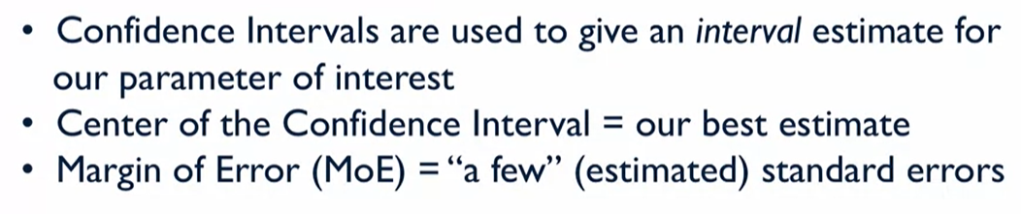
Summary

